Slide 1
DEV JATINBHAI PATEL
CE076
20CEUOS018
DBMS LAB-7

Slide 2
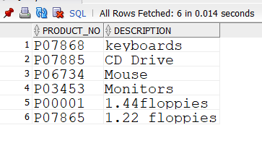
Find the product_no and description of non- moving products.
SELECT product_no,description FROM product_master
WHERE product_no IN (SELECT product_no FROM sales_order_details
WHERE s_order_no IN (SELECT s_order_no FROM sales_order
WHERE order_status = 'fulfilled' OR order_status = 'cancelled'));

Slide 3
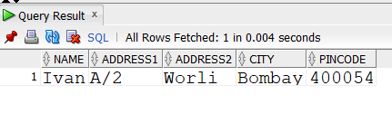
2.Find the customer name, address, city and pincode for the client who has placed order no “019001”.
select name,address1,address2, city , pincode from client_master where
client_no in (select client_no from sales_order where s_order_no = 'O19001');

Slide 4
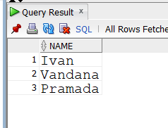
3.Find the client names who have placed an order before the month of May 96.
select name from client_master where
client_no in(select client_no from sales_order where order_date < '01-05-1996');

Slide 5
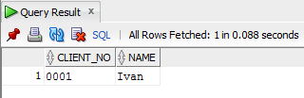
4.Find out if product “1.44 floppies” is ordered by only one client to whom it has been delivered, print the client_no, name of that client.
select client_no,name from client_master
where client_no in(select client_no from sales_order
where order_status = 'fulfilled' AND s_order_no in(select s_order_no
from sales_order_details
where product_no in(select product_no from product_master
where description = '1.44floppies' group by(product_no) having
count(client_no)=1)));

Slide 6
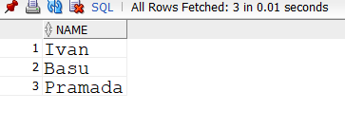
5. find the names of client who have placed orders worth Rs.10000 or more.
select name from client_master
where client_no in(select client_no from sales_order
where s_order_no in(select s_order_no from sales_order_details group
by(s_order_no) having sum(qty_order*product_rate)>=10000)
group by(client_no));

Slide 7
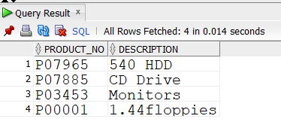
6.Select the orders placed by ‘Ivan’
select product_no , description from product_master where product_no in
(select product_no from sales_order_details where s_order_no in
(select s_order_no from sales_order where client_no in
(select client_no from client_master where name = 'Ivan')));

Slide 8
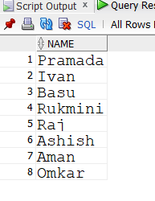
7. Select all the clients and the salesman in the city of Bombay.
(select name from client_master where city = 'Bombay' group by name)
UNION all
(select sal_names from sales_master where city = 'Mumbai' group by sal_names);

Slide 9
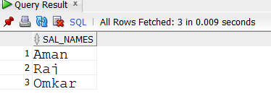
8. Select salesman name in “Bombay” who has at least one client located at “Bombay”
select sal_names from sales_master where salesman_no in
(select salesman_no from sales_order where client_no in
(select client_no from client_master where city = 'Bombay')) and sales_master.city = 'Mumbai';

Slide 10
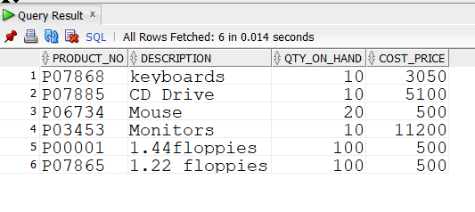
9. Select the product_no, description, qty_on-hand,cost_price of non_moving items in the product_master table.
SELECT product_no,description,qty_on_hand,cost_price FROM
product_masterWHERE product_no IN (SELECT product_no FROM sales_order_detailsWHERE s_order_no IN (SELECT s_order_no FROM sales_orderWHERE order_status = 'fulfilled' OR order_status = 'cancelled'));

